Slide 1
Fossils
Science Olympiad

Slide 2
Event Description

Slide 3
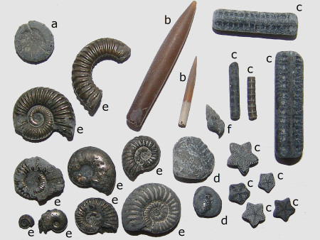
What is a Fossil
Word is Latin for “dug up”
Form in bodies of water where sedimentation occurs
The naturally preserved remains or traces of animals or plants that lived in the geologic past. There are two main types of fossils; body and trace.
Body fossils include the remains of organisms that were once living
Trace fossils are the signs that organisms were present (i.e. footprints, tracks, trails, and burrows).

Slide 4
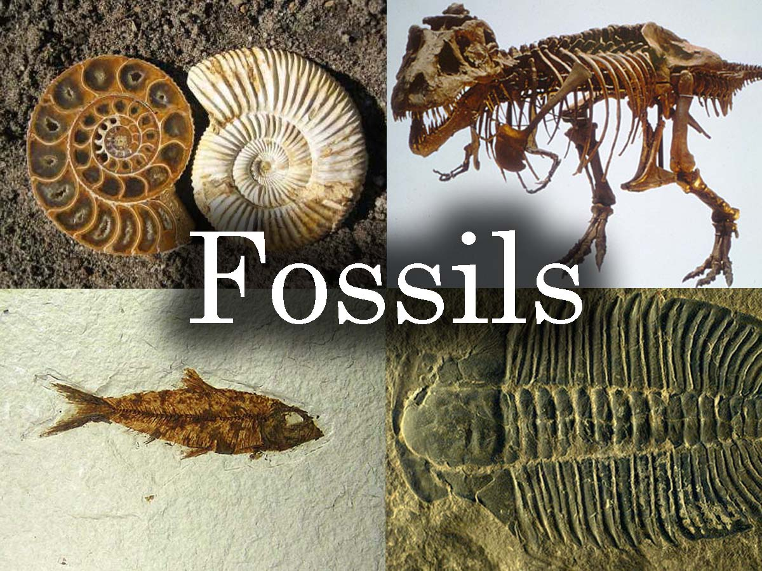
Different Types of Fossils
Mummification
External Molds
Casts
Internal Molds
Petrification/Petrifaction/Silicification
Carbonization/Coalification
Recrystallization
Replacement
Trace fossils
Actual remains
Tar

Slide 5
Unaltered Remains

Slide 6
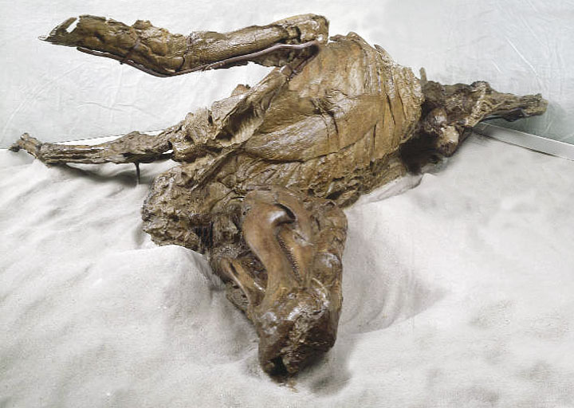
Mummification
Next in quality to frozen fossils
Preserves life form with some tissue or skin intact.
Bones very fragile
Not true fossilization just a pause in the disintegration process
Takes place in arid (void of moisture)
Mummified Edmontasaurus DInosaur

Slide 7
Impressions

Slide 8
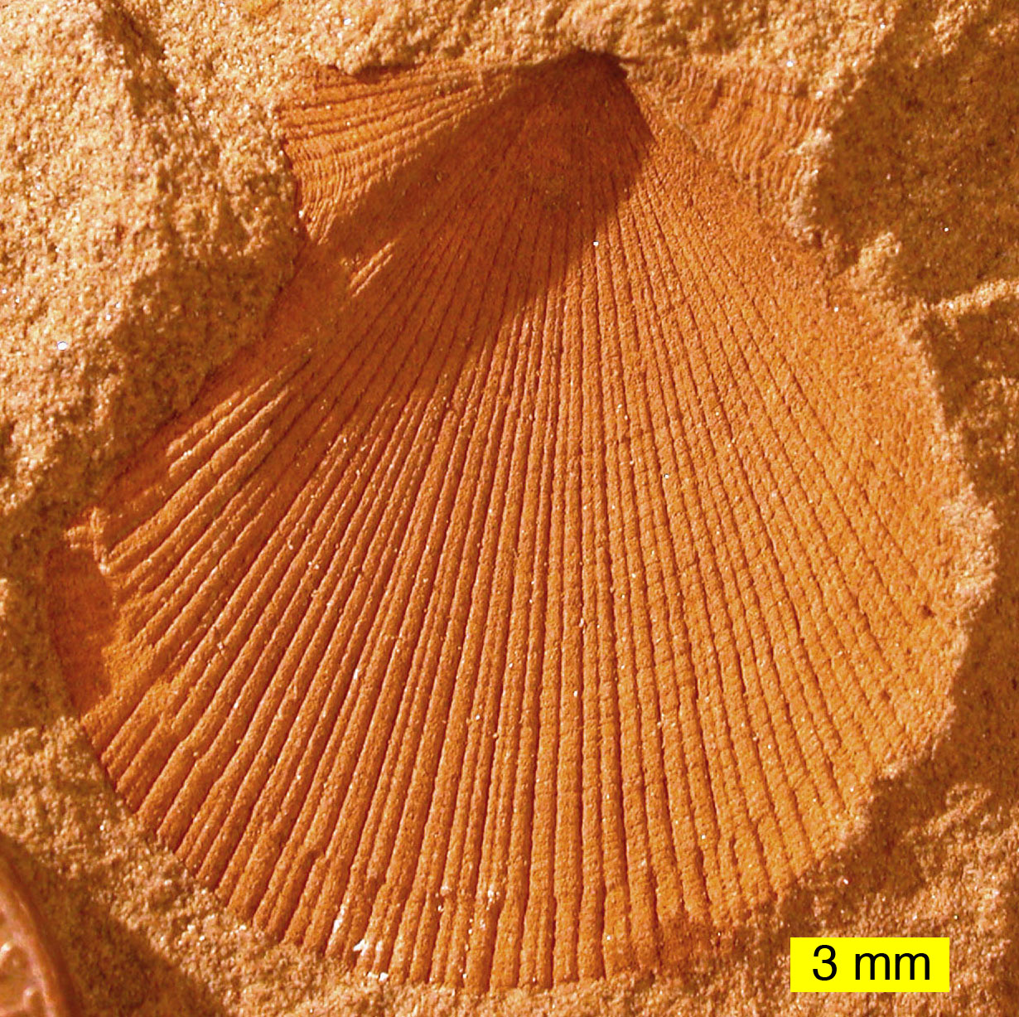
External molds
Imprints of the organism embedded in rocks
Physical characteristics of organisms are impressed onto rocks
Hard body parts allow the sediment to from around the organism
Created with the dissolution of the organic which then leaves an empty cavity imprinted with the external details of the organism
External mold of a bivalve

Slide 9
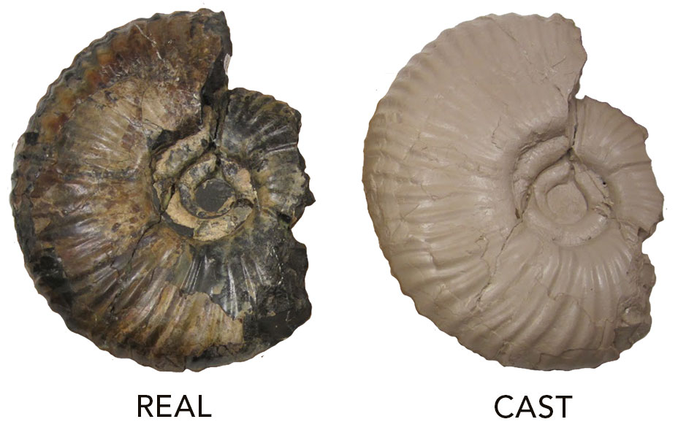
Casts
Formed when external molds are filled with sediment
We can “recreate” the structure of the organisms

Slide 10
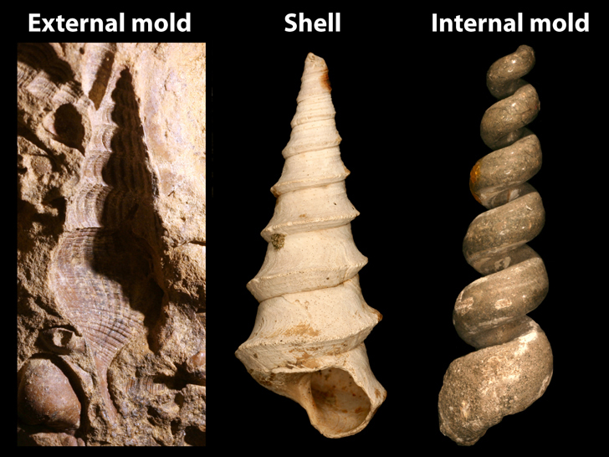
Internal Molds
When sediment fills the shell of a deceased organism (bivalve or gastropod)
These remain after the organism’s remains decompose to show the internal features of the organism
Form hollow structures
The “shell” of the organism is filled with various inorganic materials such as sediment or crystals
When the shell dissolves, it leaves an impression of the interior surface of the shells on the material

Slide 11
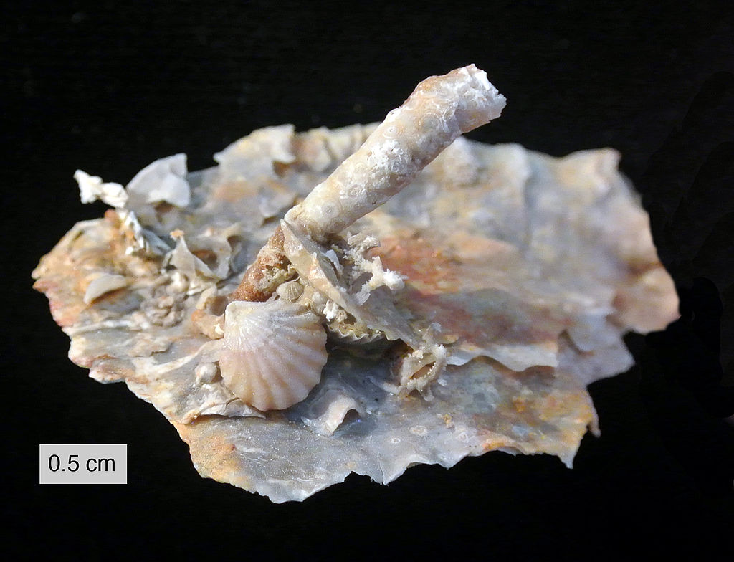
Petrification/Petrifaction/Silicification
These occur when minerals slowly replace the various organic tissues of an organism with minerals. The most common mineral to cause petrification is silicon, but other minerals will also work.
Wood is often found silicified in freshwater and terrestrial sand and silt deposits. Weathering volcanic ash supplies the silica which gradually incorporates into partially decayed wood.
Silicified fossils from Road Canyon Formation

Slide 12
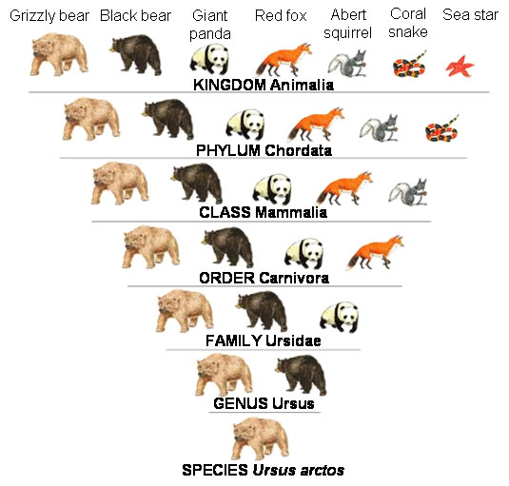
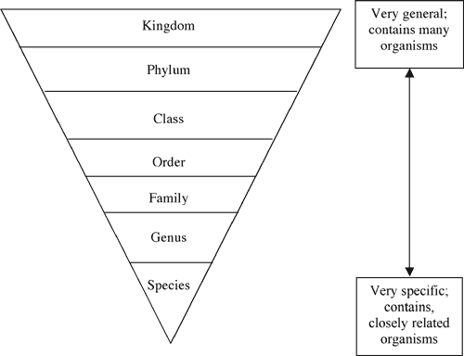
Taxonomy – Classification

Slide 13
Making a Binder
For Genus-Level Taxa
Fossil Range
Taxonomy
Mode of Life/Diet/Habitat/Distribution)
Anatomical features, size
Nicknames, common names
A picture (or many if there are various forms of the specimen)
Any other important/trivial info that should go under a misc. section (pop culture, etc)

Slide 14
Making a Binder
For Orders/Classes
The common anatomical features throughout the group
Distinctive features of the said group
Adaptations over time
The fossil range of the group
General habitats and common modes of life
Common names/ Nicknames for group
Misc. info

Slide 15
Making a Binder
For Phyla
Now you're getting into a broad range of info and less distinctive features
There are generally a few main features are shared in these large groups
Adaptations over time
Nicknames/Common names (Like Bryozoans are called Sea mats/Moss animals)
Misc. info

